Slide 1
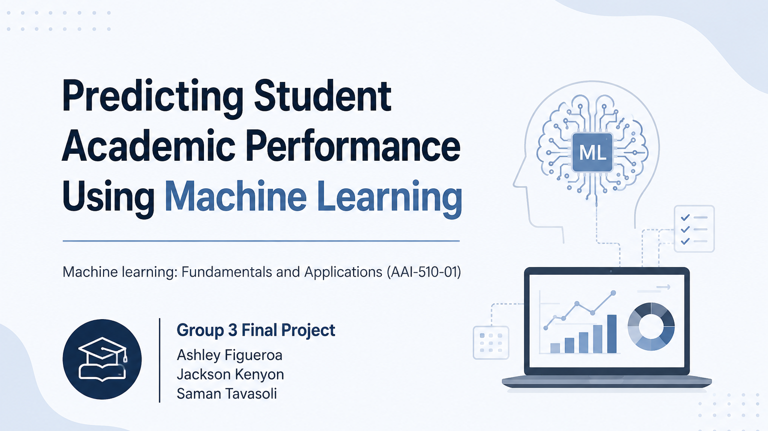

Notes:
For our AAI-510 final project, we explored how machine learning can be used to predict student academic performance and identify students who may be academically at risk before poor outcomes occur.
Schools collect a large amount of information about students, including attendance, study habits, parental involvement, and tutoring participation. However, identifying students who need support early enough for meaningful intervention remains a significant challenge.
Our goal was to develop a machine learning solution that can analyze these factors and serve as an early warning system for educators. Throughout this presentation, we'll discuss the business problem, the dataset and analysis process, the machine learning models we evaluated, our results, and our recommendations for real-world deployment.
To begin, let's look at the challenges schools face when trying to identify struggling students.

Slide 2

BUSINEES PROBLEM
Challenges
Schools often identify struggling students only after academic performance has already declined.
Consequences
Missed intervention opportunities
Lower student success rates
Inefficient allocation of support resources
Increased risk of long-term academic failure
Goal
Develop a machine learning model that predicts which students are academically at risk so educators can intervene earlier.
Notes:
Now that we've introduced the project, let's discuss the business problem we set out to solve.
Schools collect a large amount of information about their students, including attendance, study habits, tutoring participation, extracurricular activities, and family support. However, many schools still struggle to identify students who are beginning to fall behind until poor performance becomes visible through grades or assessments.
This creates a reactive approach rather than a proactive one. By the time a student starts failing classes, valuable opportunities for early intervention may already have been missed.
As shown on this slide, late identification can lead to several challenges. Students may not receive timely academic support, counseling, or tutoring when they need it most. It can also negatively impact student success, reduce engagement, and make it more difficult for schools to use their limited resources effectively. In the long term, continued academic struggles can increase the risk of lower graduation rates and reduced educational opportunities.
Because of these challenges, our goal was to develop a machine learning solution that could identify academically at-risk students before poor outcomes occur. By doing so, educators could intervene earlier, provide targeted support, and make more informed decisions about resource allocation.
To build this solution, we first needed to understand the data available to us and determine whether it contained meaningful indicators of academic risk. Let's take a closer look at the dataset we used and how we defined academic risk in this project.

Slide 3
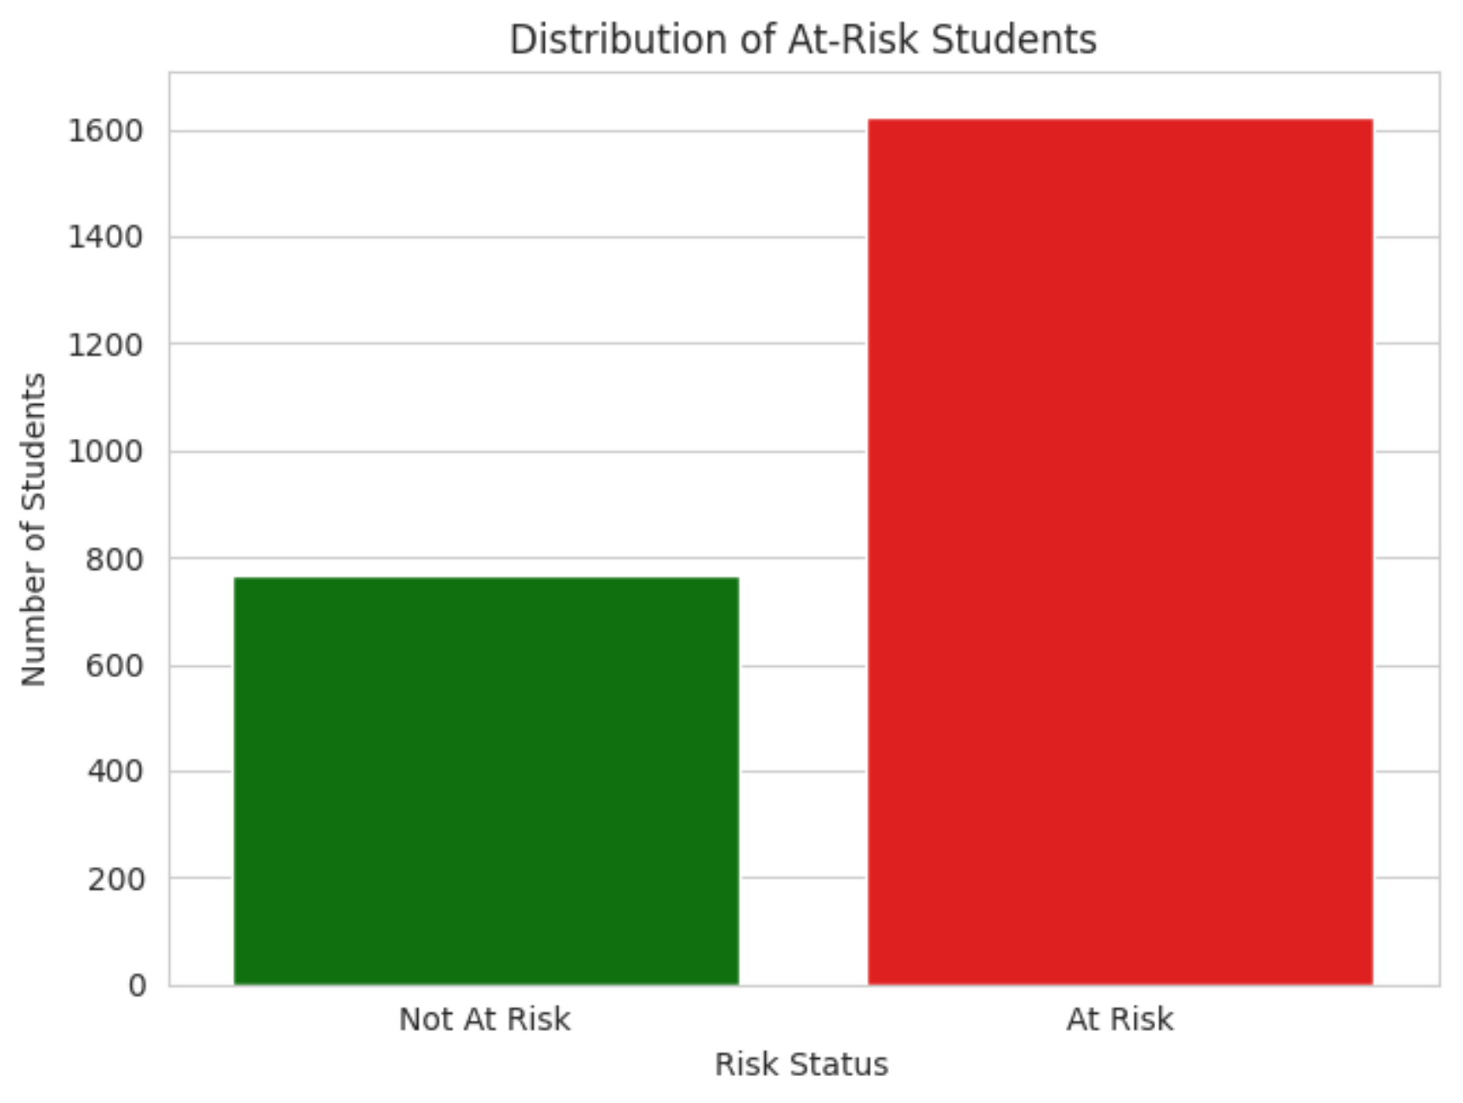
DATASET OVERVIEW
Student Performance Dataset
2,392 student records
Academic and behavioral information
Demographic and support-related factors
Examples of Features
Attendance
Study Time
Tutoring
Parental Support
Extracurricular Activities
Business Outcome
Predict whether a student is academically at risk.
Notes:
After defining the business problem, the next step was understanding the data available to help solve it.
For this project, we used a student performance dataset containing 2,392 student records. The dataset included a variety of academic, behavioral, demographic, and support-related factors that may influence student success. Some examples include attendance, study time, tutoring participation, parental support, extracurricular activities, and physical activity.
One of our first tasks was defining what it means for a student to be academically at risk. To create a business-focused target variable, we classified students earning D or F grades as "At Risk" and students earning A, B, or C grades as "Not At Risk."
This allowed us to frame the problem as a binary classification task, where the goal is to predict whether a student may require additional academic support.
On the right side of the slide, you can see the distribution of students in each category. Approximately 1,625 students were classified as at risk and 767 students as not at risk. Because the dataset is somewhat imbalanced, we used multiple evaluation metrics throughout the project rather than relying on accuracy alone.
Overall, this dataset provided a strong foundation for building predictive models and understanding the factors associated with academic risk.
Once we understood the structure of the dataset, we performed exploratory data analysis to identify patterns and determine which factors appeared to have the strongest relationship with academic risk.

Slide 4
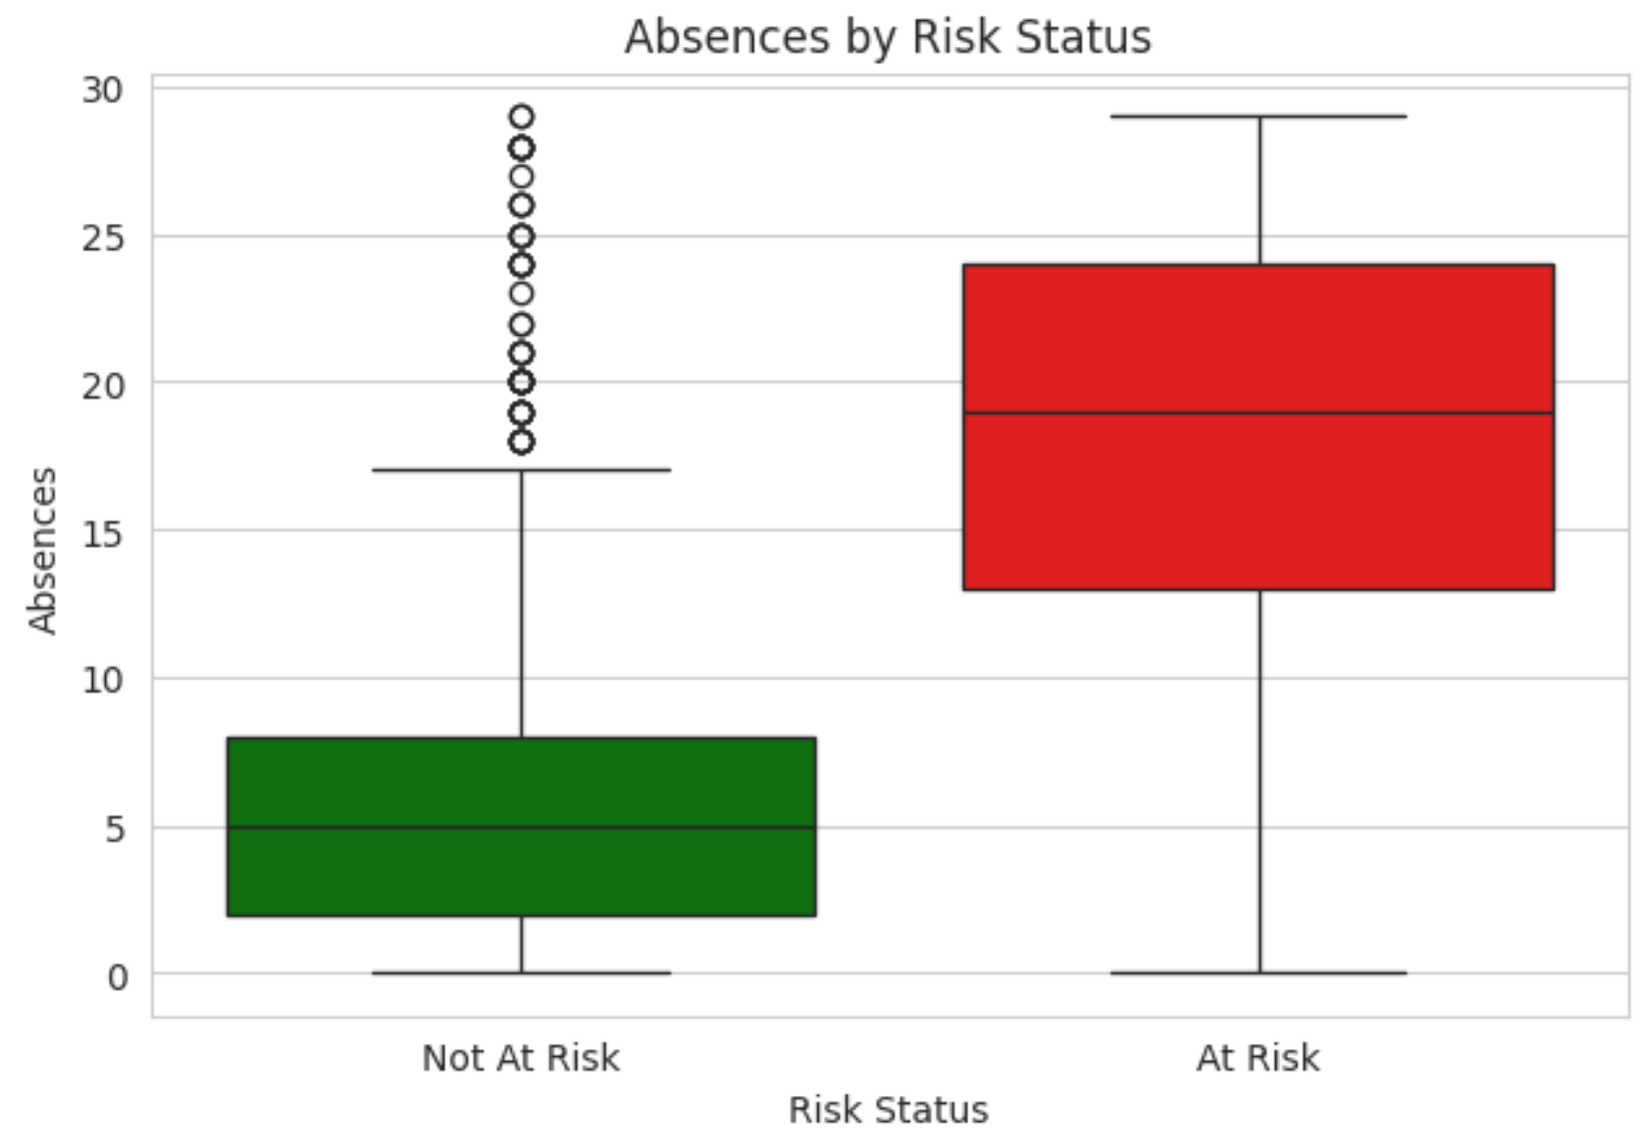
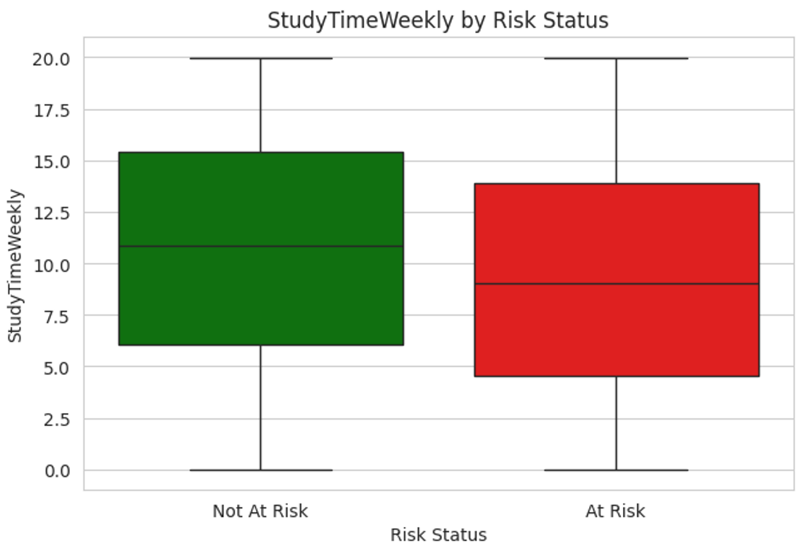
DATA UNDERSTANDING & KEY INSIGHTS
Key Findings From Exploratory Analysis
Students At Risk Tend To
Miss more classes
Study fewer hours
Receive less parental support
Participate in fewer academic support activities
Most Important Observation
Attendance and study behavior consistently showed strong relationships with academic performance.
Notes:
After gaining an understanding of the dataset, we performed exploratory data analysis to identify patterns that could help explain academic risk.
The purpose of this phase was not only to prepare the data for machine learning but also to understand which student behaviors and support factors were most closely related to academic performance.
One of the strongest findings involved attendance. Looking at the chart on the left, students classified as at risk generally had significantly higher numbers of absences than students who were not at risk. This suggests that poor attendance is strongly associated with academic difficulties and may serve as an early warning sign for educators.
The second chart shows weekly study time. Here we see another clear pattern: students who were not at risk tended to spend more time studying each week, while at-risk students generally studied fewer hours. This highlights the importance of consistent study habits in supporting academic success.
Our broader analysis also showed that at-risk students were more likely to report lower parental support, participate less in tutoring programs, and demonstrate lower levels of academic engagement.
An important takeaway is that many of these factors are actionable. Schools can improve attendance monitoring, expand tutoring opportunities, encourage stronger study habits, and provide additional support resources to students who may be struggling.
Overall, this analysis not only helped prepare the data for modeling but also provided valuable insights that educators can use to improve student outcomes.
With these relationships identified, the next step was preparing the data and selecting the appropriate features for machine learning.

Slide 5
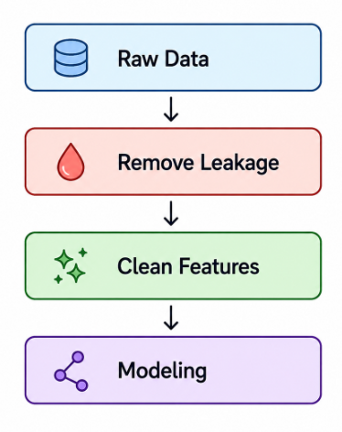
DATA PREPARATION & FEATURE SELECTION
Preparing Data for Machine Learning
Data Quality
No significant missing values
No duplicate records
Clean dataset structure
Removed Features
StudentID
GPA
GradeClass
GradeClassLabel
Why?
Prevent data leakage and ensure realistic predictions.
Final Dataset
Focused on information available before final academic outcomes occur.
Notes:
After identifying the factors associated with academic risk, the next step was preparing the data for machine learning.
The dataset was already in very good condition, with no significant missing values, no duplicate records, and a clean structure. This allowed us to focus more on model development than data cleaning.
One of the most important steps was preventing data leakage. To ensure realistic predictions, we removed StudentID, GPA, GradeClass, and GradeClassLabel because they either provided no predictive value or were directly related to the final academic outcome.
Instead, we limited the model to information that schools would realistically have before final grades are assigned, such as attendance, study habits, parental support, and tutoring participation.
By removing these variables, we created a more reliable foundation for prediction. As shown in the workflow diagram, the data moved from raw inputs to cleaned features before entering the modeling phase.
With the data prepared and the final features selected, we were ready to evaluate several machine learning models and determine which approach performed best.

Slide 6
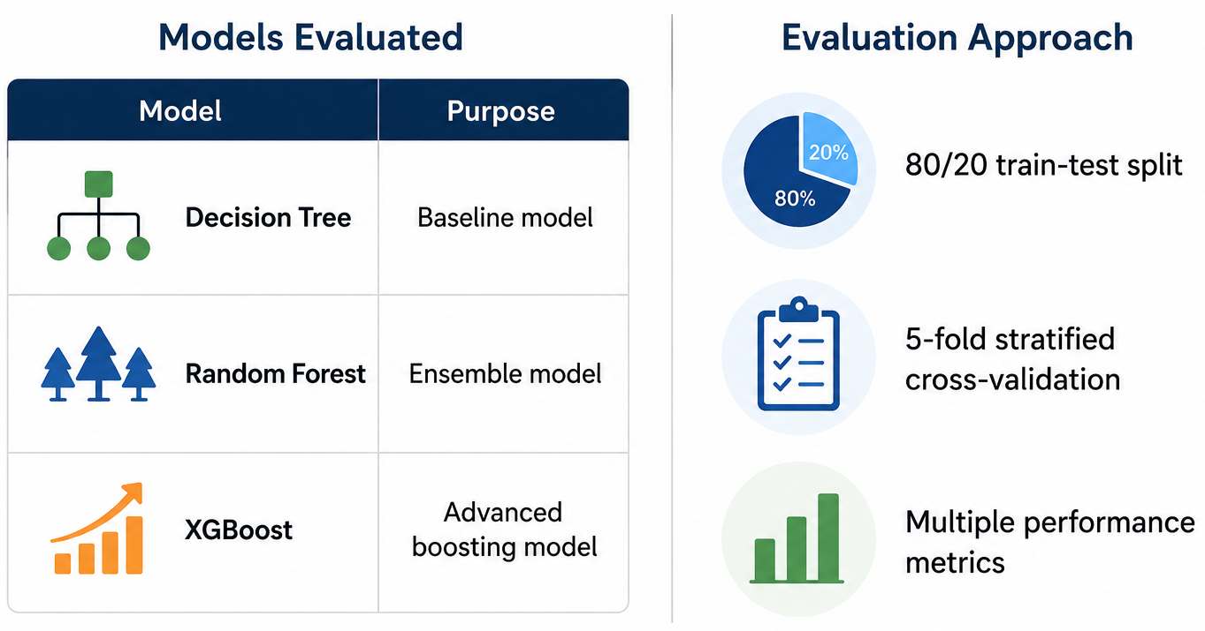
MACHINE LEARNING MODELS EVALUATED
Notes:
After preparing the data and selecting the final features, we moved into the modeling phase of the project.
Our goal was to determine which machine learning approach could most accurately identify students who were academically at risk.
To do this, we evaluated three models: Decision Tree, Random Forest, and XGBoost.
The Decision Tree served as our baseline model, while Random Forest and XGBoost represented more advanced ensemble approaches designed to improve predictive performance.
To ensure a fair comparison, we used an 80/20 train-test split along with five-fold stratified cross-validation.
We evaluated each model using multiple metrics, including accuracy, precision, recall, F1 score, and ROC-AUC, to gain a complete view of performance.
With this framework in place, we were ready to compare the models and identify the strongest candidate for deployment.

Slide 7
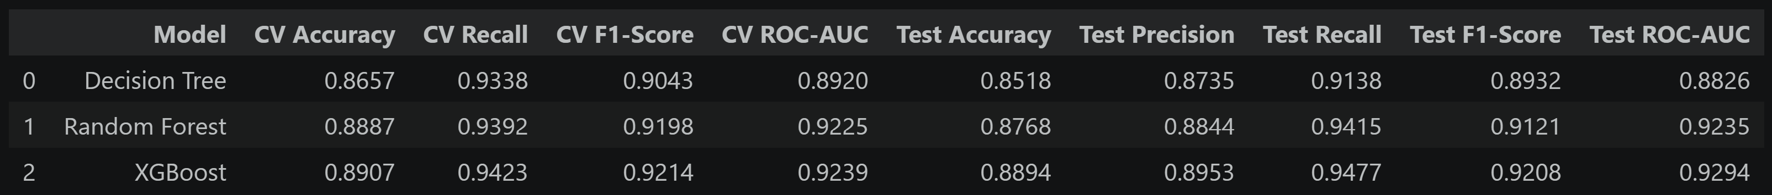
MODEL PERFORMANCE COMPARISON
Which Model Performed Best?
Results Summary
Findings
All models performed well
Ensemble methods outperformed the Decision Tree
XGBoost achieved the strongest overall performance
Notes:
After training all three machine learning models, we compared their performance using both cross-validation and test results.
The table summarizes the key metrics for each model. In addition to accuracy, we evaluated recall, F1 score, and ROC-AUC to gain a more complete view of performance.
Recall was especially important because it measures how well the model identifies students who are actually at risk. Missing these students could mean missing opportunities for early intervention.
All three models performed well, showing that the dataset contained meaningful predictive patterns. However, Random Forest and XGBoost consistently outperformed the Decision Tree.
Among all models, XGBoost achieved the best overall results, including the highest recall, F1 score, and ROC-AUC values. It also maintained strong performance on unseen test data, indicating that it generalized well.
Based on these results, we selected XGBoost as our final model and explored whether further optimization could improve its performance even more.
Although XGBoost was already the top performer, we wanted to see if tuning its parameters could make it even more effective at identifying at-risk students. The next step was optimizing the model and evaluating its final performance.

Slide 8
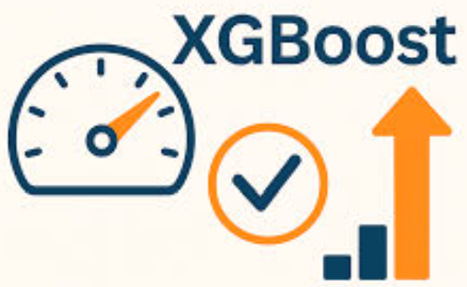
XGBOOST OPTIMIZATION
Improving the Best Model
Optimization Process
Hyperparameter tuning
Cross-validation
Performance validation
Result
Optimized XGBoost improved predictive reliability and became the final recommended model.
Notes:
After comparing all three machine learning models, XGBoost achieved the best overall results. However, before selecting it as our final model, we wanted to see if its performance could be improved through optimization.
We performed hyperparameter tuning combined with five-fold cross-validation to test different model settings and identify the most effective configuration.
The optimized XGBoost model achieved the strongest overall results, maintaining high accuracy while improving predictive reliability and recall. This was especially important because our goal was to identify as many at-risk students as possible.
We also confirmed that the model performed well on unseen data, showing that it learned meaningful patterns rather than simply memorizing the training set.
Based on these results, the optimized XGBoost model became our final recommended solution.
Now let's look at the final performance results and see how effectively the model identifies academically at-risk students.

Slide 9
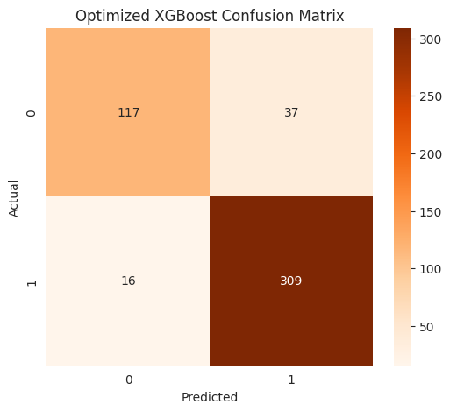
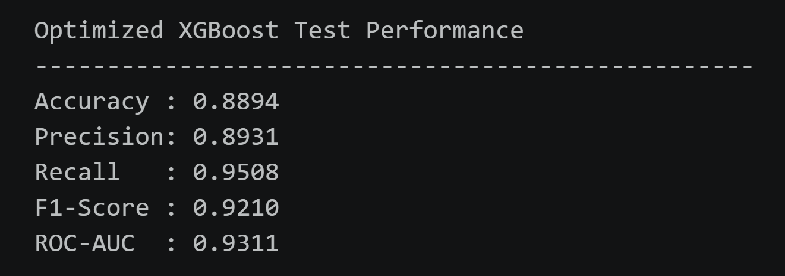
FINAL MODEL PERFORMANCE
Improving the Best Model
Final XGBoost Results
Key Business Metric
95% Recall
The model successfully identifies most at-risk students.
Notes:
After optimizing the XGBoost model, we evaluated its performance using a separate test dataset that the model had never seen before. This allowed us to assess how well it would perform on new student records in a real-world setting.
The results were very strong across all major evaluation metrics. The model achieved an accuracy of approximately 89 percent, meaning that nearly nine out of ten students were classified correctly. It also achieved a precision of about 89 percent, indicating that when the model predicts a student is at risk, it is usually correct.
However, the most important metric for this project is recall. Our optimized model achieved a recall of approximately 95 percent, meaning it successfully identified about 95 percent of students who were actually at risk. This is especially important because missing an at-risk student could delay intervention and support.
On the right side of the slide, the confusion matrix provides a detailed breakdown of the predictions. The model correctly identified 309 students who were truly at risk, while only 16 at-risk students were missed. This low number of missed students is one of the main reasons the model achieved such a high recall score.
Overall, these results show that the optimized XGBoost model is both accurate and highly effective at identifying students who may need academic support.
Understanding that the model performs well is only part of the story. It is equally important to understand which student characteristics contribute most strongly to academic risk. Let's look at the factors driving the model's predictions.

Slide 10
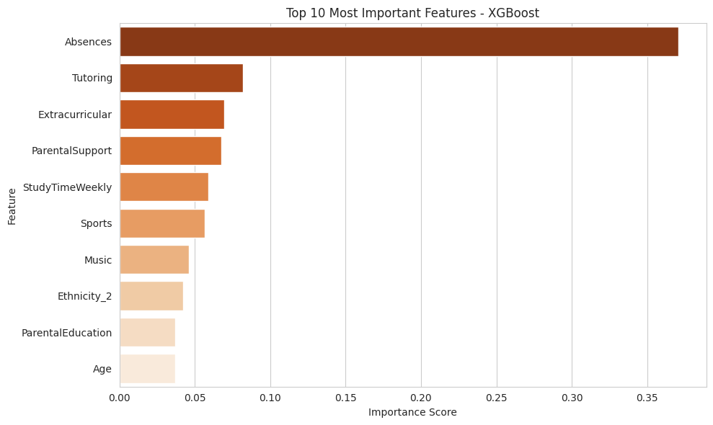
WHAT DRIVES STUDENT RISK?
Most Important Risk Factors
Top Predictors
Absences
Study Time
Parental Support
Tutoring Participation
Educational Engagement
Business Insight
Student success is strongly influenced by attendance, study habits, and support systems.
Notes:
Now that we've demonstrated the model's strong performance, the next question is: what factors are actually driving student risk?
One advantage of XGBoost is that it allows us to measure feature importance, helping us understand which variables have the greatest influence on the model's predictions.
As shown in the chart, the most important factor by a significant margin was student absences. This reinforces one of the key findings from our exploratory analysis: students who miss school more frequently are much more likely to experience academic difficulties.
Other important factors included tutoring participation, extracurricular involvement, parental support, and weekly study time. These findings are especially valuable because many of these factors are actionable. Schools can improve attendance monitoring, expand tutoring opportunities, encourage stronger study habits, and increase student engagement through targeted support programs.
Another notable finding is the importance of parental support, suggesting that family involvement continues to play a meaningful role in academic success.
Overall, this analysis moves the project beyond prediction alone. The model is not simply identifying which students may be at risk—it is helping us understand where schools can focus their resources to make the greatest impact.
The key takeaway is that attendance, study habits, engagement, and support systems are among the strongest predictors of student success and represent areas where meaningful interventions can be made.
While the model provides strong predictive performance and valuable insights, any real-world deployment must also consider ethical responsibilities, privacy concerns, and operational implementation. Let's look at those considerations next.

Slide 11
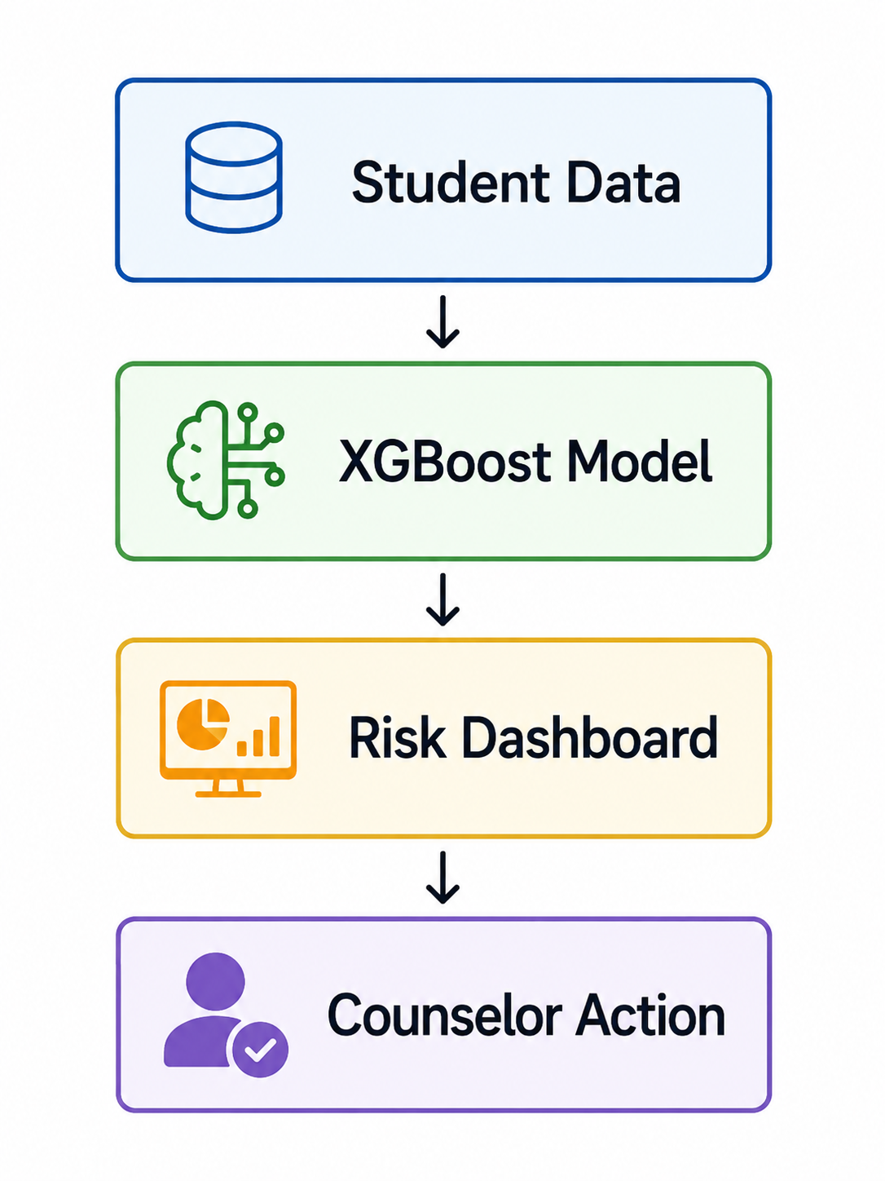
RISKS, ETHICS & DEPLOYMENT
Risks and Deployment Strategy
Risks
Potential prediction bias
Data privacy concerns
Overreliance on automated decisions
Mitigations
Human review of predictions
Regular model monitoring
Student data protection policies
Deployment
Weekly batch prediction system
Student Data → XGBoost → Risk Dashboard → Counselor Intervention
Notes:
As we move from model development to real-world implementation, it's important to recognize that successful deployment involves more than just strong predictive performance.
Any machine learning system used in education must be implemented responsibly, with careful attention to fairness, privacy, and operational considerations.
One potential concern is prediction bias. Because machine learning models learn from historical data, schools should regularly monitor performance across different student groups to ensure fair and equitable outcomes.
Another important consideration is data privacy. Student records often contain sensitive information, so access to predictions should be limited to authorized personnel and managed according to privacy regulations and institutional policies.
We must also avoid overreliance on automation. While the model can provide valuable insights, it should support—not replace—the judgment of educators, counselors, and administrators.
To address these concerns, we recommend regular model monitoring, strong data governance practices, and human review of all predictions before intervention decisions are made.
On the right side of the slide, you can see our recommended deployment process. Student data would be collected and processed on a weekly basis, the XGBoost model would generate risk scores, and the results would be displayed in a dashboard for counselors and administrators. These predictions could then be used to guide tutoring, attendance support, counseling, and other intervention efforts.
Our recommendation is not to replace educators with artificial intelligence, but to provide them with better information so they can make more informed decisions.
After evaluating the business problem, analyzing the data, developing multiple machine learning models, and considering deployment requirements, we can now summarize our final recommendation and conclusions.

Slide 12
Recommendation & Conclusion
Final Recommendation
Deploy the Optimized XGBoost model as an early-warning system for identifying academically at-risk students.
Benefits
Earlier intervention
Better resource allocation
Improved student outcomes
Data-driven decision making
Final Result
95% Recall
Strong ability to identify students needing support.
Notes:
As we conclude our presentation, I'd like to summarize the key findings and recommendations from our project.
Our goal was to determine whether machine learning could be used to identify students who are academically at risk before poor outcomes occur. Based on our results, the answer is clearly yes.
We evaluated several machine learning models, including Decision Trees, Random Forest, and XGBoost. While all three performed well, XGBoost consistently delivered the strongest results. After optimization, the final model achieved approximately 89 percent accuracy and over 95 percent recall, meaning it successfully identified the vast majority of students who were actually at risk.
In addition to strong predictive performance, our analysis revealed several important factors associated with academic success. Attendance emerged as the most influential predictor, followed by tutoring participation, parental support, study habits, and student engagement.
Based on these findings, we recommend deploying the optimized XGBoost model as an early-warning system. Rather than waiting for grades to decline, schools could proactively identify students who may need support and intervene earlier through tutoring, counseling, attendance programs, and other targeted resources.
The expected benefits include earlier intervention, better resource allocation, improved student outcomes, and more data-driven decision-making.
It is important to emphasize that this system is not intended to replace educators. Instead, it is designed to provide teachers, counselors, and administrators with additional information to help them make more informed decisions and better support their students.
The greatest value of this project is not simply predicting who may struggle. It is giving educators the opportunity to help students before they struggle.
Thank you for your time and attention.

